Slide 1
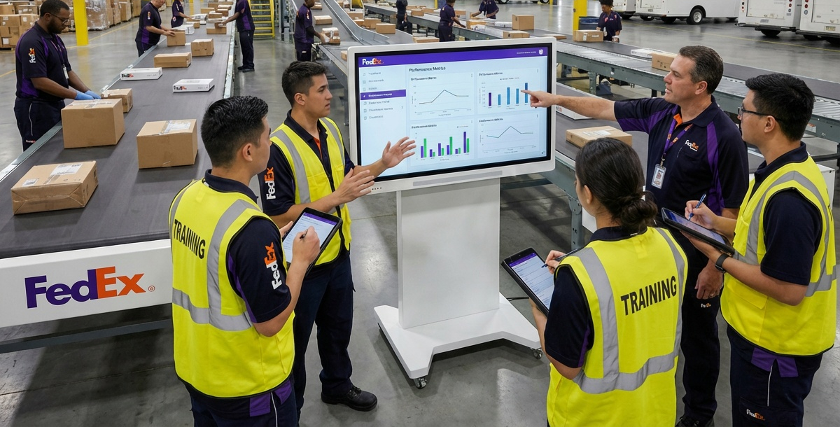
Simulation for Learning & Development
A modern training approach that converts SOPs into interactive, repeatable practice—reducing classroom load and improving retention.

Slide 2
Why Simulation Works
• Hands-on learning
• Immediate feedback
• Safe practice environment
• Supports all learning styles

Slide 3

Training Workflow Integration
1. Introduce concepts in the classroom
2. Practice in simulation
3. Reinforce with coaching on the floor
4. Validate readiness with scores

Slide 4
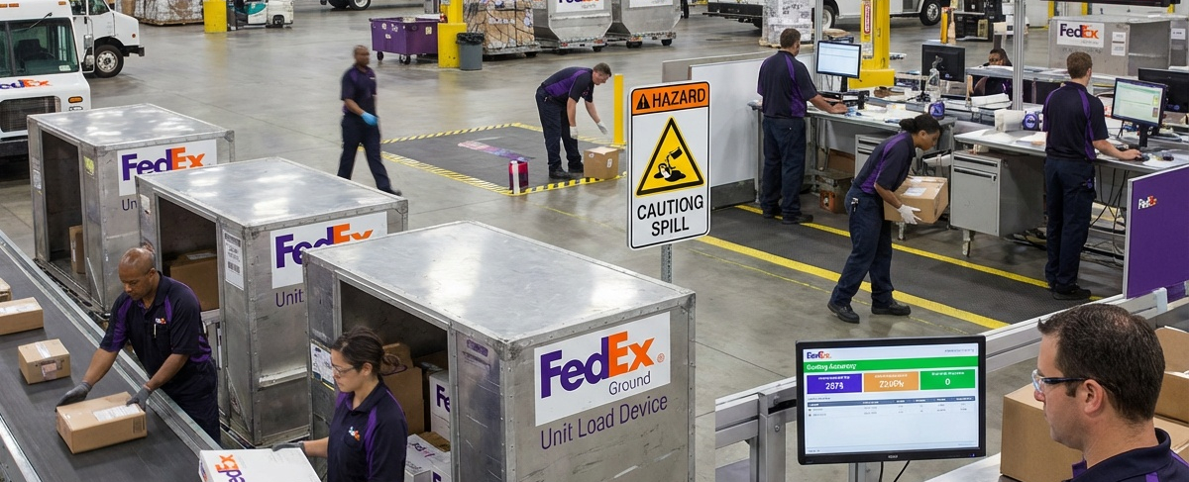
Scenario-Based Learning
• Belt-to-ULD loading
• Scanning & sorting accuracy
• Hazard identification
• Time-pressure decision making

Slide 5
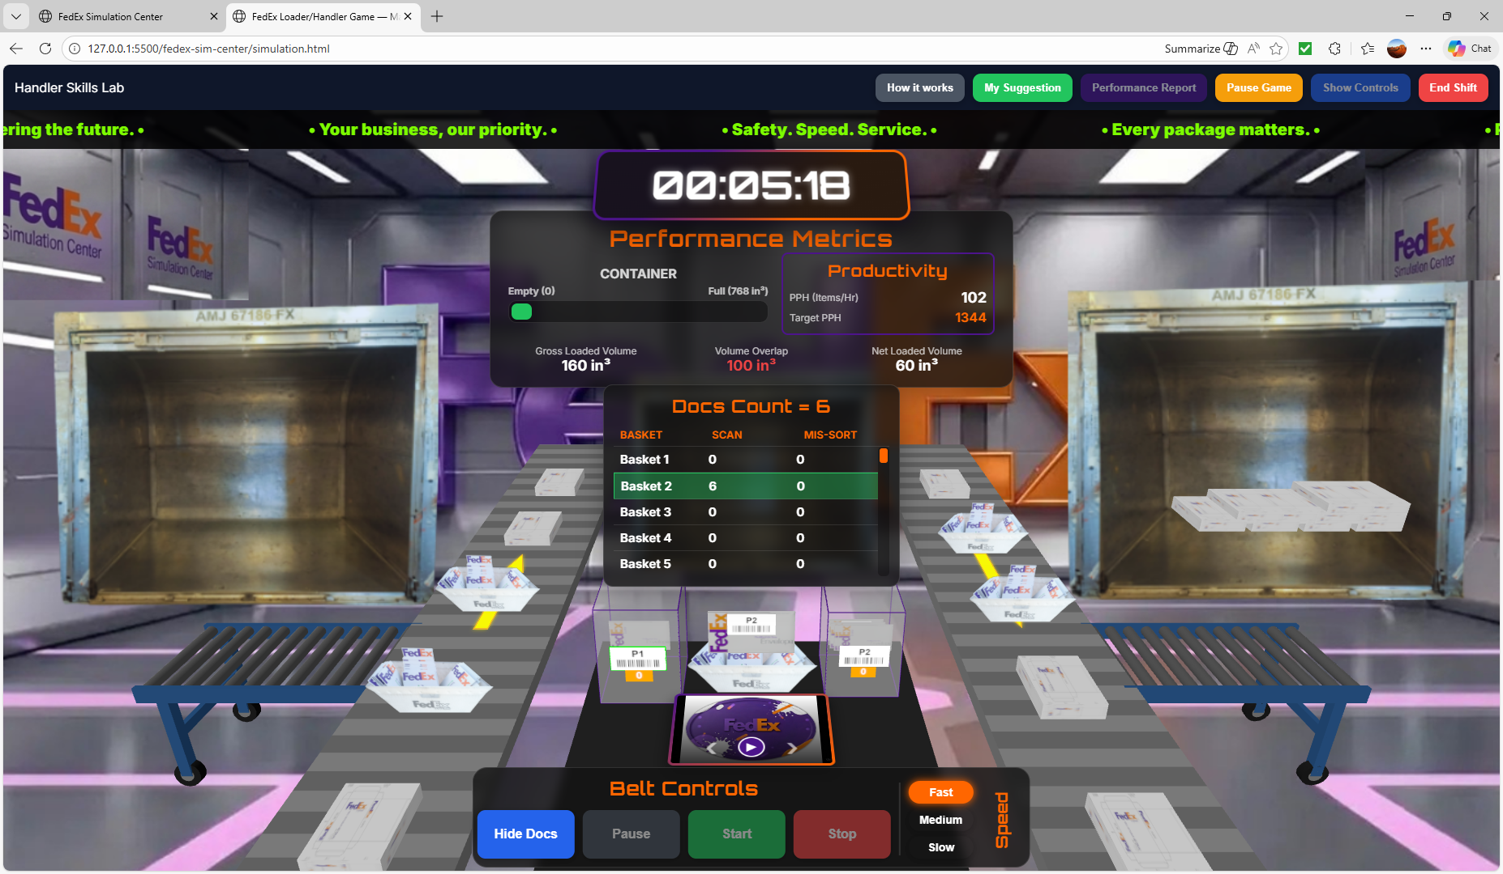
Performance Metrics
• Speed & cycle time
• Sort accuracy / mis-sorts
• Loading quality scores
• Safety compliance behaviors

Slide 6
Instructor Tools
• View trainee attempts
• Identify error patterns
• Assign targeted scenarios
• Track competency over time

Slide 7
Adaptability & Updates
Training modules update quickly as SOPs evolve—no major video reshoots or reprints required.

Slide 8
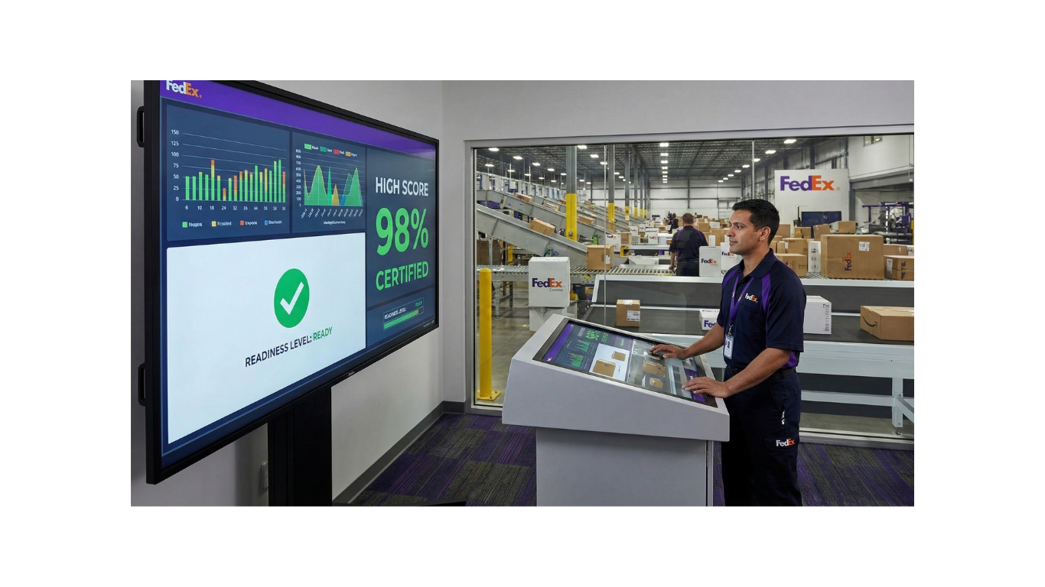
Certification & Readiness
Simulation scores can be used as an additional readiness signal before live package handling.

Slide 9
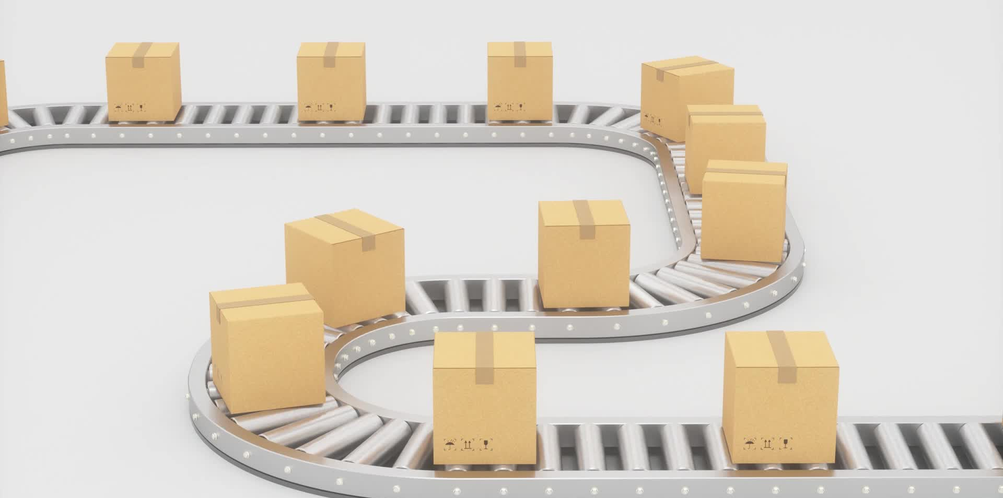
Support for All Roles
• Handlers
• Ramp agents
• Couriers & drivers
• Operations leaders

Slide 10
Training Team Impact
• Less time correcting early mistakes
• More consistent coaching
• Higher trainee confidence on Day 1

