Slide 1

Welcome to The
FedEx Simulation Center
A new way to learn the job—through interactive, hands-on practice that builds confidence before touching live volume.

Slide 2

What You Will Learn
• Sorting and scanning basics
• Belt flow and package movement
• How to load safely and correctly
• How to avoid common mistakes

Slide 3
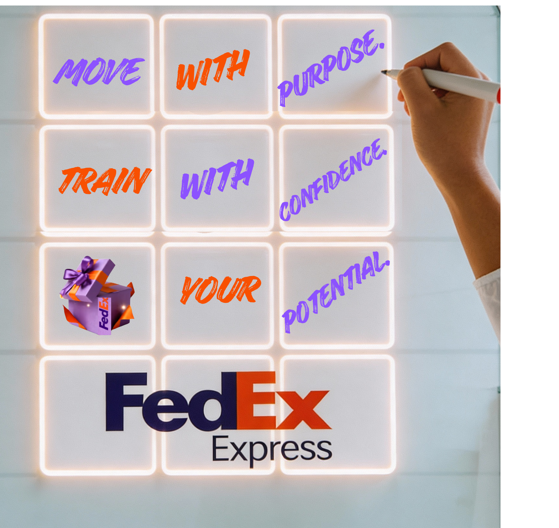
Practice Without Pressure
Make mistakes safely, learn quickly, and retry as needed—no risk, no rush.

Slide 4
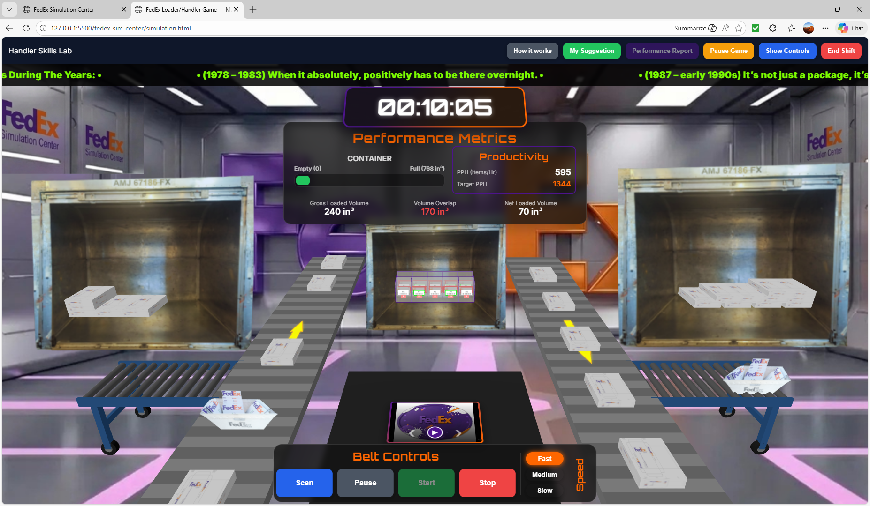
Realistic Scenarios
Simulations reflect the real FedEx environment, including belts, ULDs, scan rules, and decision points.

Slide 5


Guided Feedback
The system highlights successes and errors so you always know what to improve next.

Slide 6

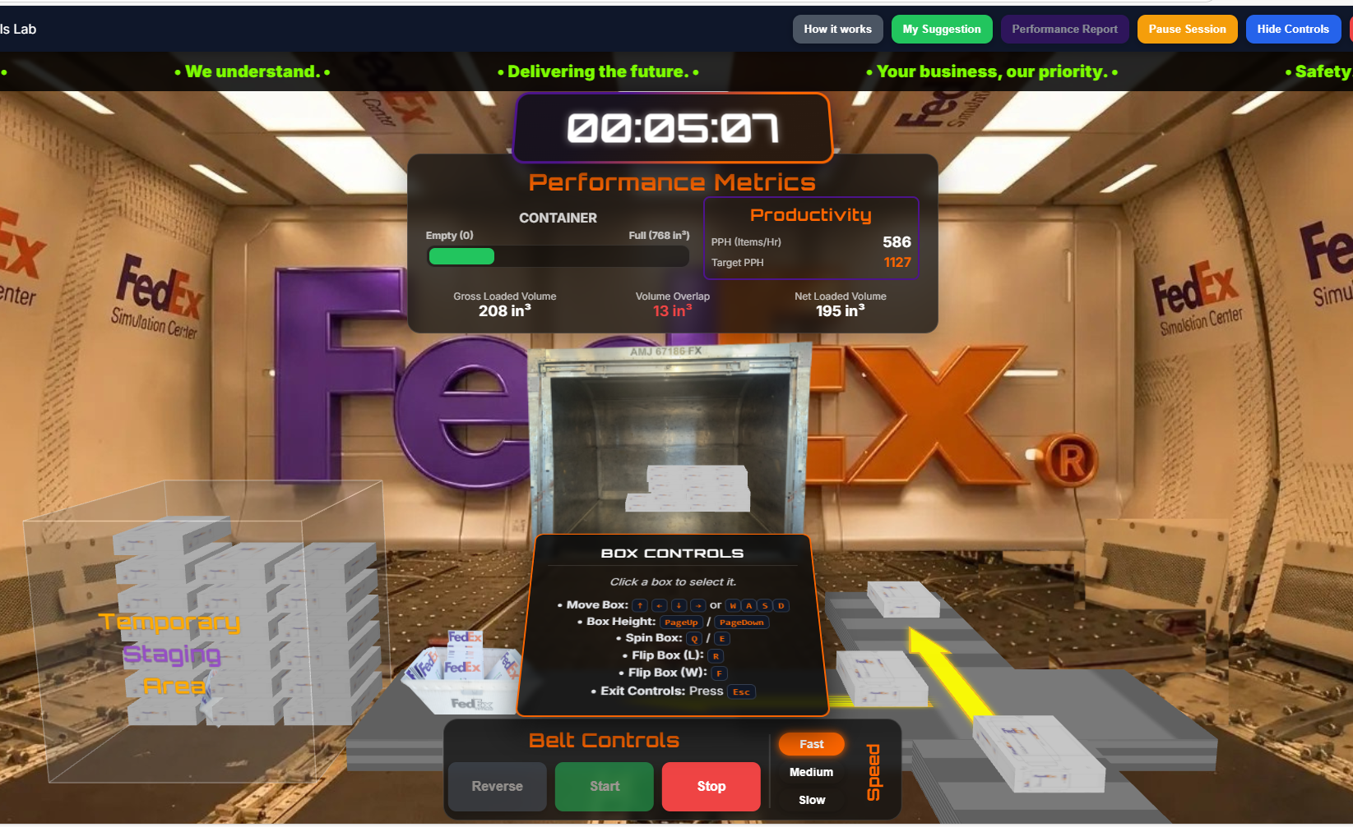
Build Confidence Early
By the time you step onto the floor, the motions and decisions already feel familiar.

Slide 7

Your Journey Starts Here
Learn the skills. Build the instincts. Become part of the FedEx team.

