Slide 1

Simulation Center
Leadership Overview
Why It Matters
Faster time-to-competence
Improved safety and risk reduction
Higher quality and consistency across stations
Better decision-making under real operational conditions
Strategic Advantage
Simulation updates faster and at lower cost than video—allowing training to stay aligned with current operations, equipment, and procedures.
Recommended Next Steps
Pilot → Measure → Refine → Scale
Built by FedEx, for FedEx. A modern training environment designed to accelerate frontline readiness
through role-based simulation.
The Challenge
Frontline roles demand speed, precision, and safety from day one. Traditional training methods struggle to fully prepare employees for
real operational pressure, while leaders face constant change
in volume, SOPs, and staffing.
The Solution
The FedEx Simulation Center enables employees to practice real workflows
in a risk-free, interactive environment—building skill, judgment, and confidence before live operations

Slide 2

Executive Summary
What it is (Simulation Center)
Why it matters (safety, ramp-up, quality)
What leaders get (data, consistency, faster readiness)
What’s next (pilot)

Slide 3

FedEx Simulation Center
Built by FedEx, for FedEx. A modern training environment that develops frontline skills through role-based simulation.

Slide 4

Why This Matters Now
High turnover and increasing ramp-up pressure
Rising safety and quality expectations across operations
Need to standardize frontline readiness across stations, hubs, and regions
A scalable way to combine hands-on practice with built-in guidance, ensuring consistent performance from day one

Slide 5

From Watching to Doing
Traditional videos show the job once.
Simulation lets people practice decisions and movements repeatedly until they become instinctive.
• Bridging the gap between
theory (video) and practice (doing)
Simulation is the intersection of theory
and practice—where learning becomes
performance.

Slide 6
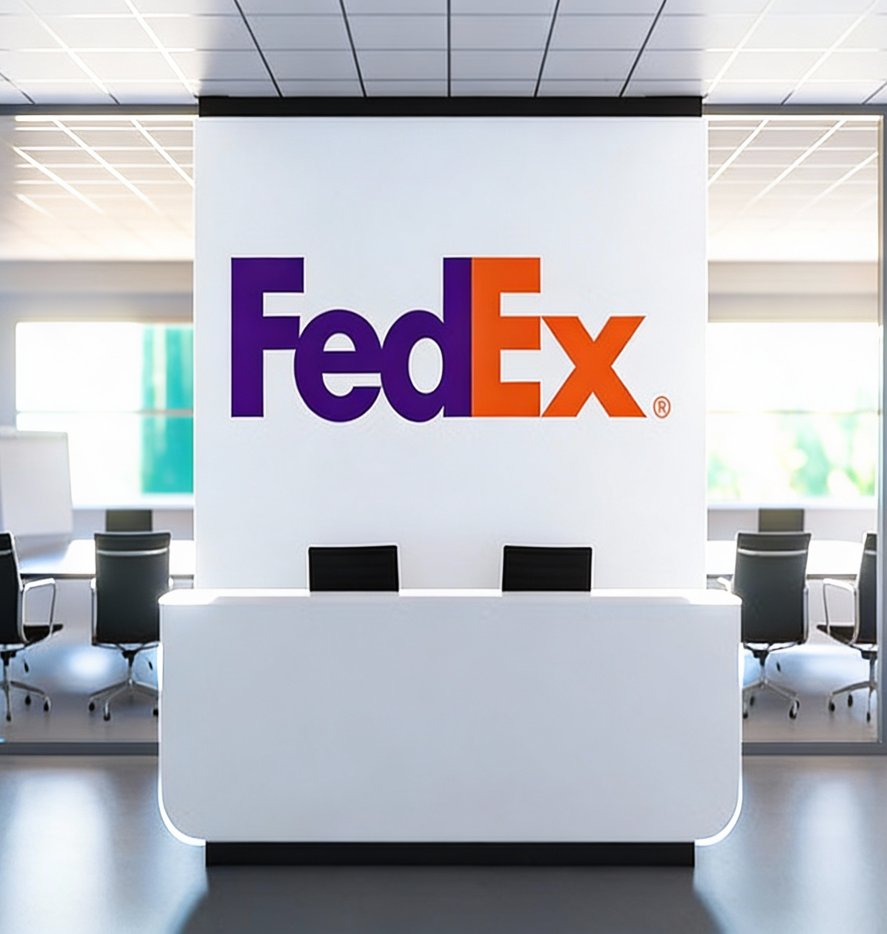

Business Impact Overview
• Faster time-to-competence for new hires
• Reduced mis-sorts and rework
• Fewer safety exposures during early learning
• More consistent training across the network

Slide 7

Safety & Risk Reduction
• New handlers practice in a zero-risk, digital environment
• Common mistakes surfaced safely before touching live volume
• Reinforces correct behaviors and SOPs

Slide 8

Quality & Service
• Better loading decisions improve cube and utilization
• Fewer mis-sorts and handling errors
• More reliable service performance and customer experience

Slide 9

Standardized, Scalable Training Role-Aligned Training with Built-In Coaching
Same scenarios deployed across locations for consistent outcomes
Role-based modules for handlers, drivers, and leaders
Training aligned with FedEx procedures, language, and standards
Built-in performance detection identifies when coaching is needed
Instant Coaching: targeted video guidance delivered immediately based on simulation performance

Slide 10
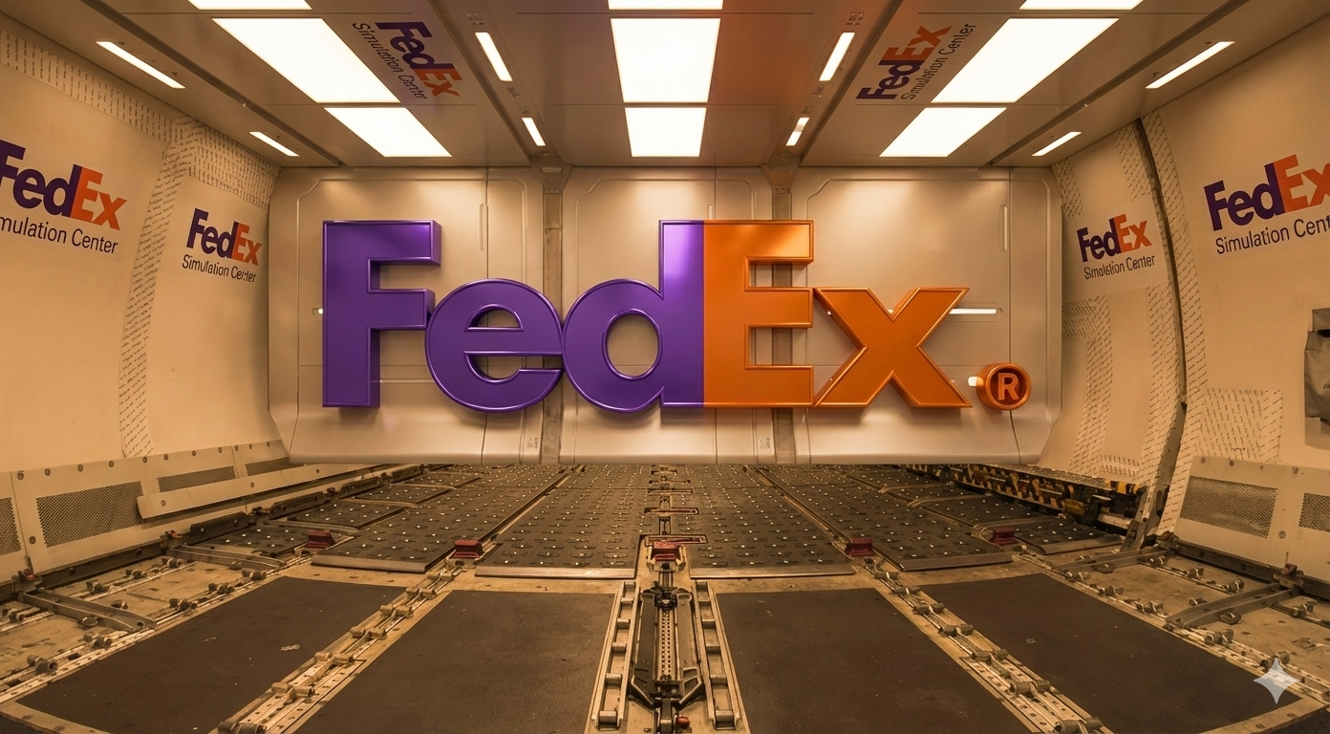
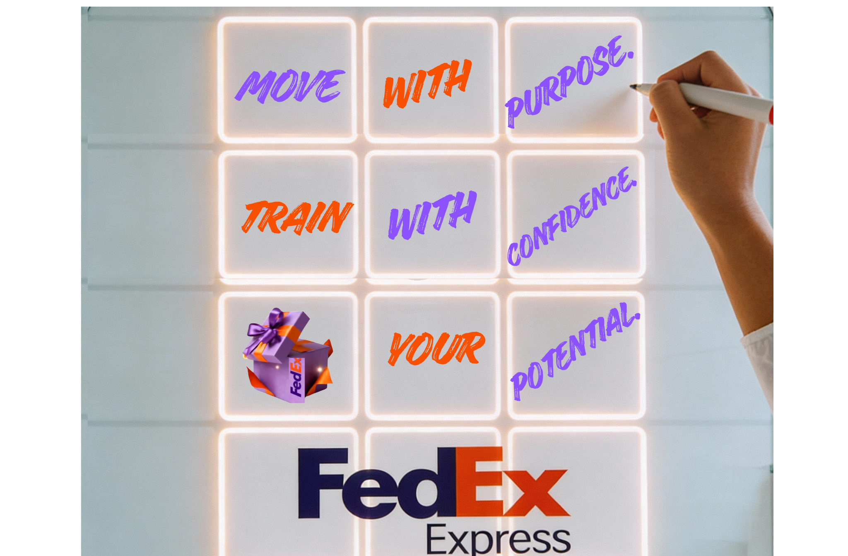
Faster, Cheaper Updates vs. Video
• SOP or process changes are reflected by updating rules and scenarios
• No need to reshoot full training videos
• Training can evolve alongside operations

Slide 11
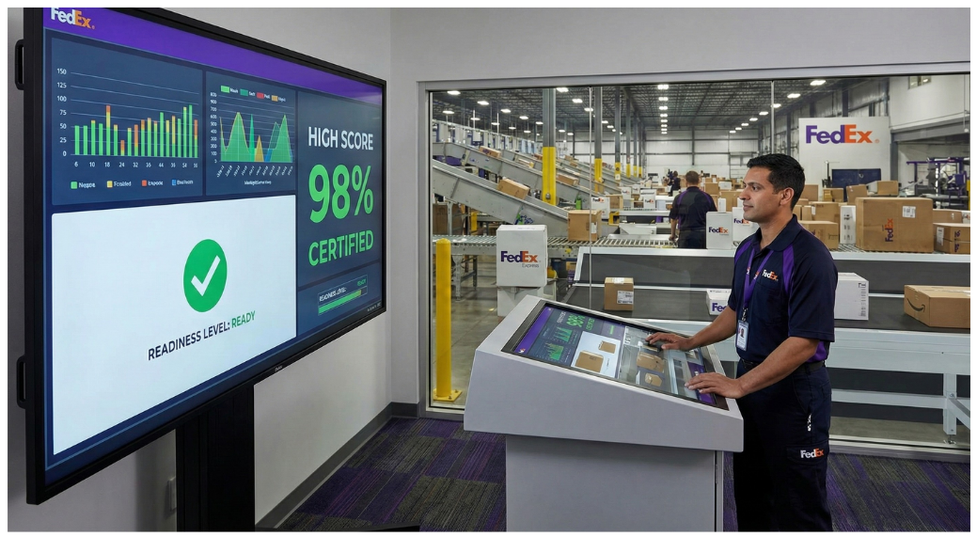

Measurable Performance Data
• Track speed, accuracy, mis-sorts, and loading quality
• Use scores as an additional readiness signal
• Identify where extra coaching is needed

Slide 12
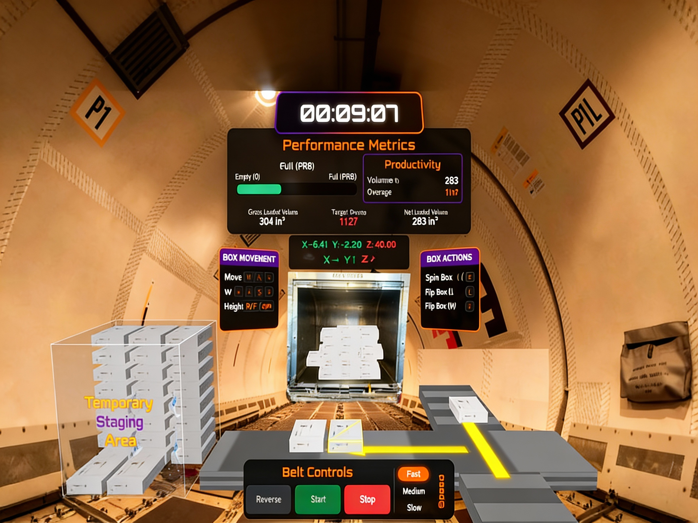
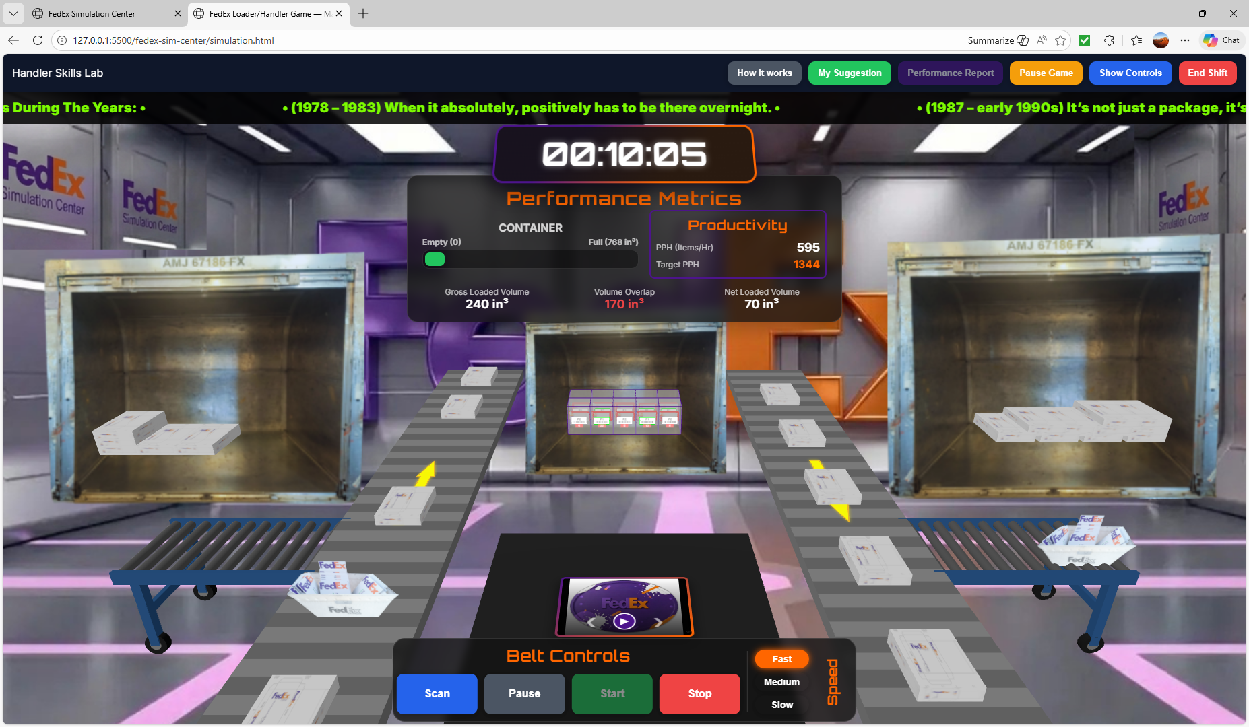
Example: Package Handler – ULD Loading
• Learn scanning, sorting, and loading in a realistic belt-to-ULD flow
• Experience time pressure and utilization decisions
• Receive feedback on loading quality and errors

Slide 13
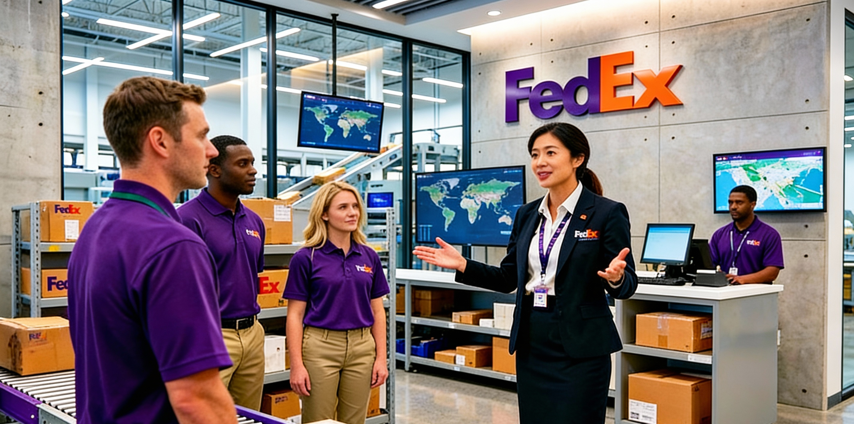
Scale Across Roles
• Handlers and ramp agents
• Couriers/drivers
• Operations managers and leaders
• Customer service and support functions

Slide 14

Leaders’ Call to Action
• Identify priority roles and stations for pilot
• Align on success metrics (safety, quality, ramp-up time)
• Partner with training teams to deploy and iterate
• The Simulation Center is an investment in people that pays back in safer, faster, higher-quality operations.

Slide 15
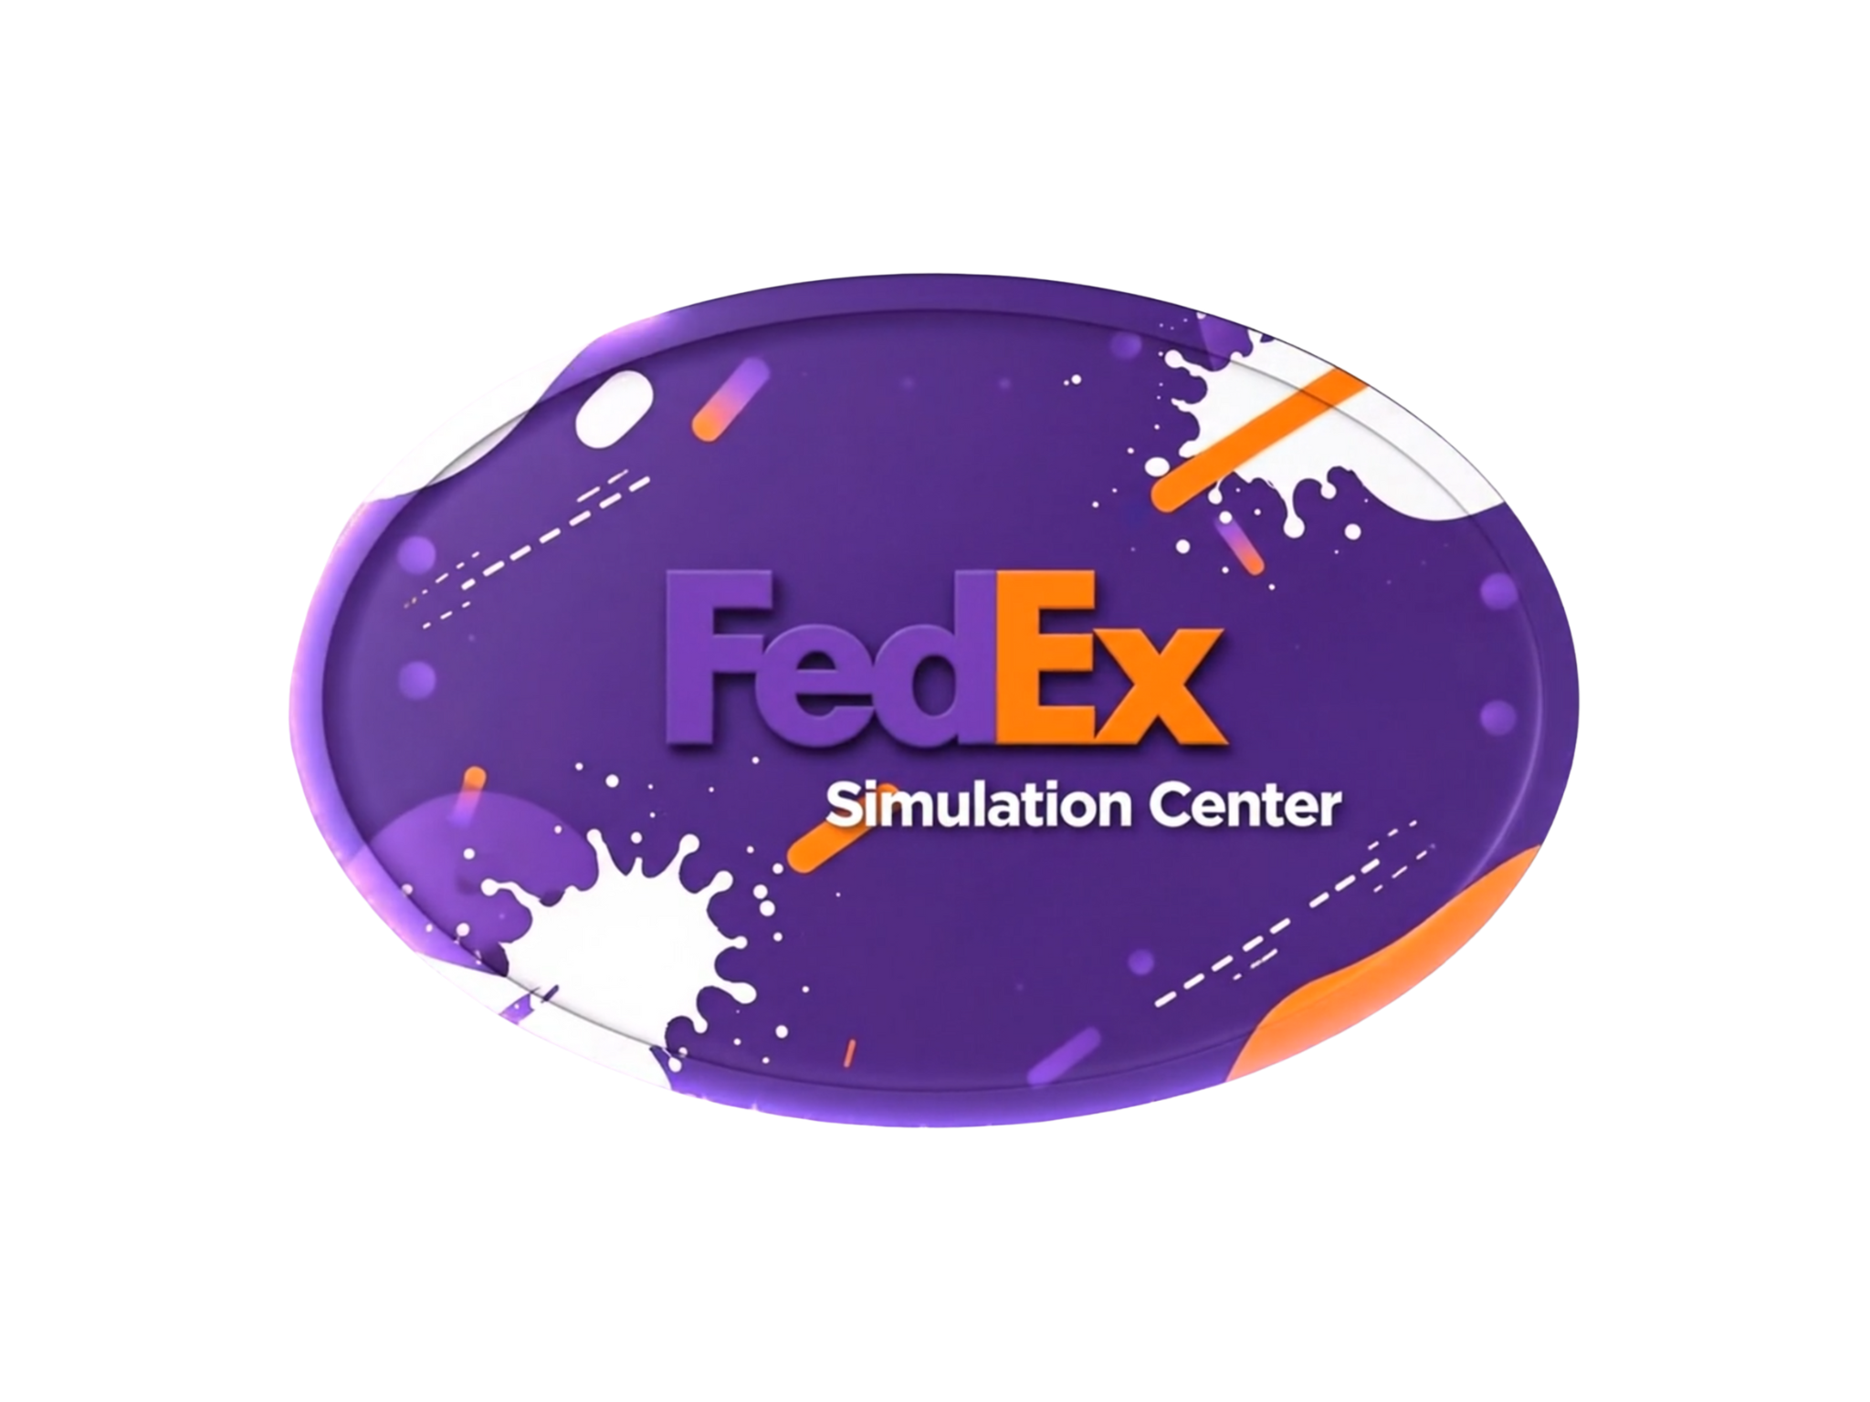
Operational Value
The FedEx Simulation Center enables employees to practice real-world workflows in a risk-free, interactive environment, building skills, judgment, and confidence before live operations. Simulation shifts training from observation to performance, allowing FedEx to measure readiness and reduce operational risk before employees impact live volume.
Financial Value
From a financial perspective, simulation converts training from a recurring variable expense into a scalable platform investment, with improved unit economics as adoption expands across the network.

